Slide 1
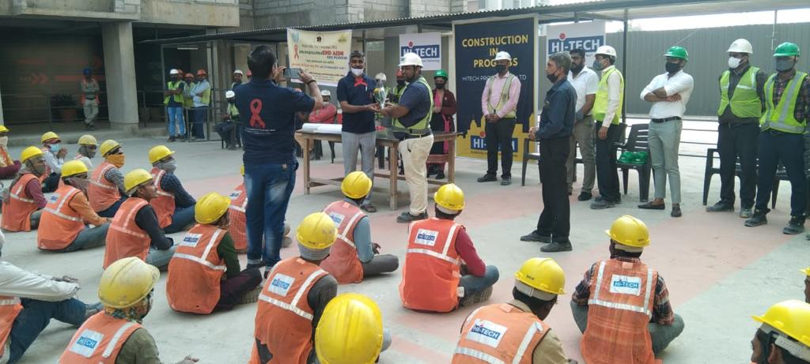
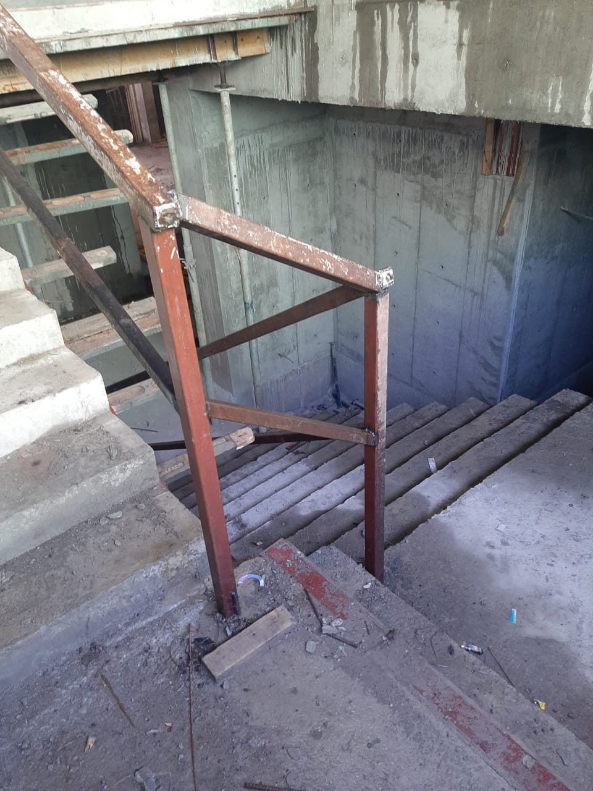
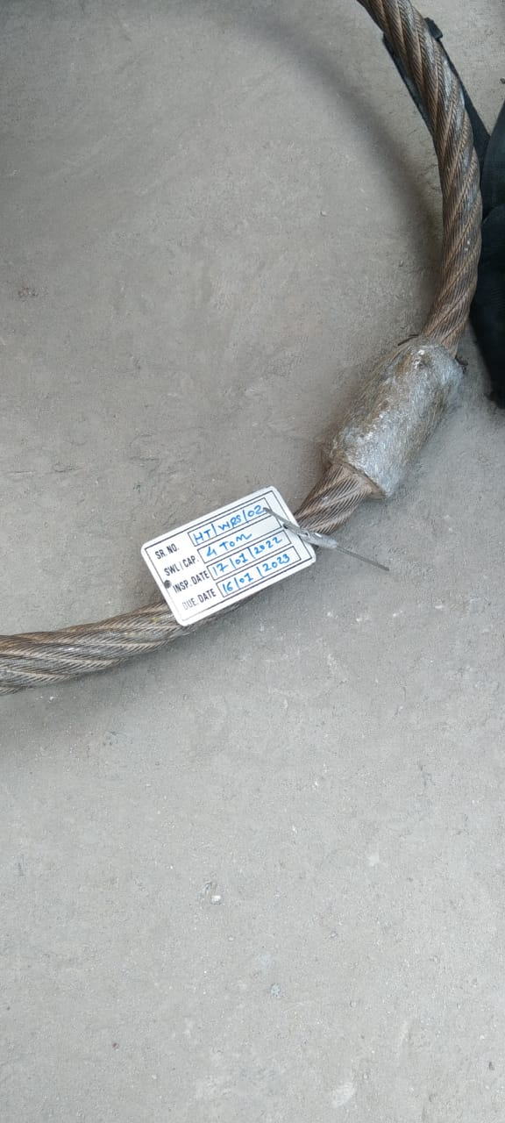
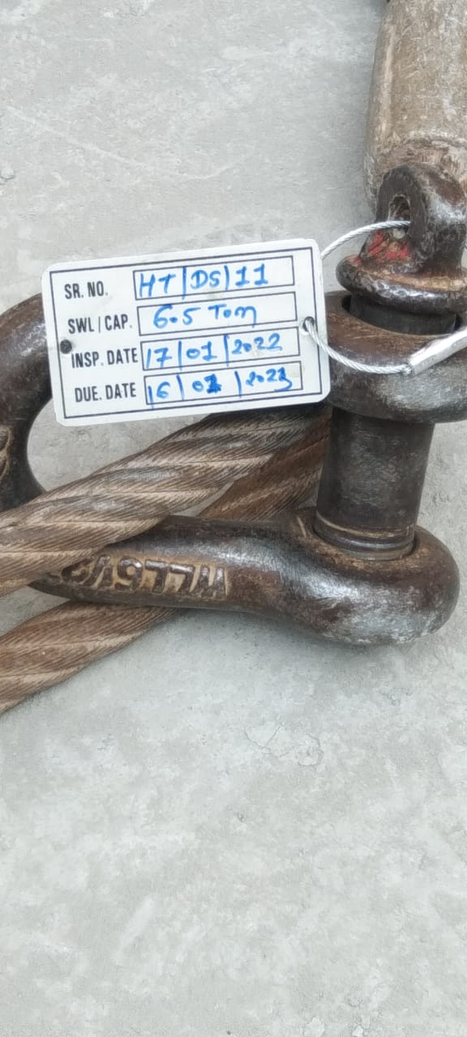
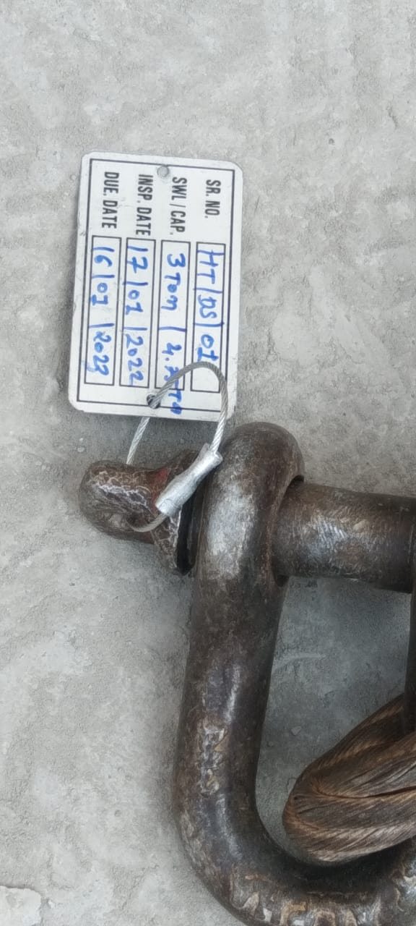
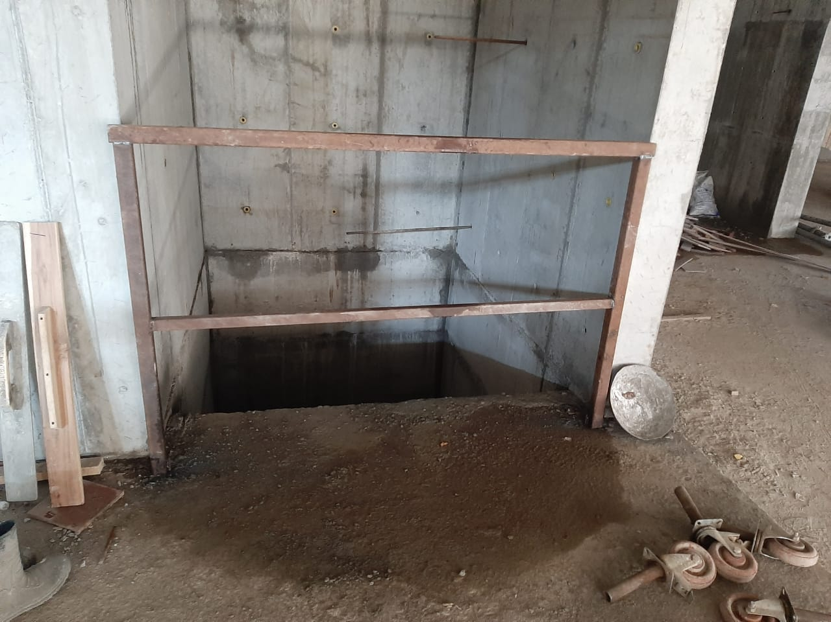
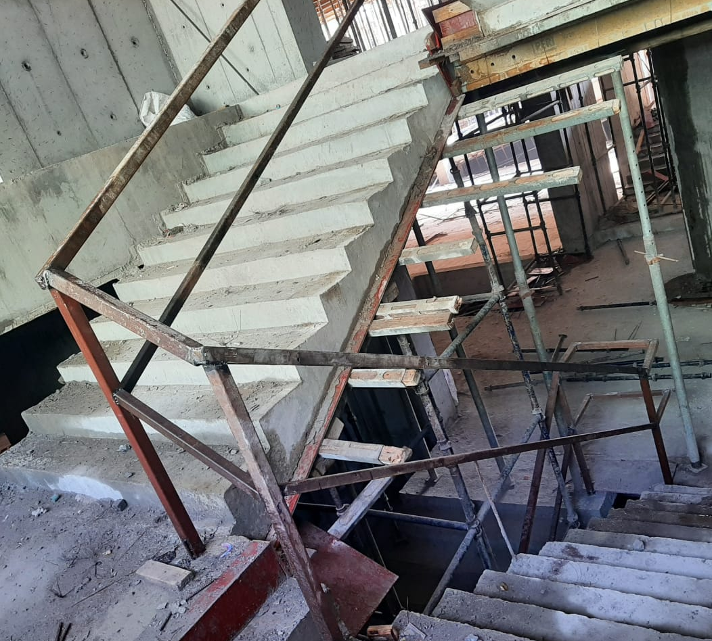

PHOTOS OF GOOD PRACTICES
MONTH- JAN 2022
Aids awareness training Site:- Sun atmosphere
Provision of hard barricading on stairs edges Site:- venus pashmina
Proper tagging ststem Site:- Sun atmosphere
Provision of edge protection Site:- venus pashmina
PROJECT REVIEW MEETING – SAFETY REVIEW

Slide 2
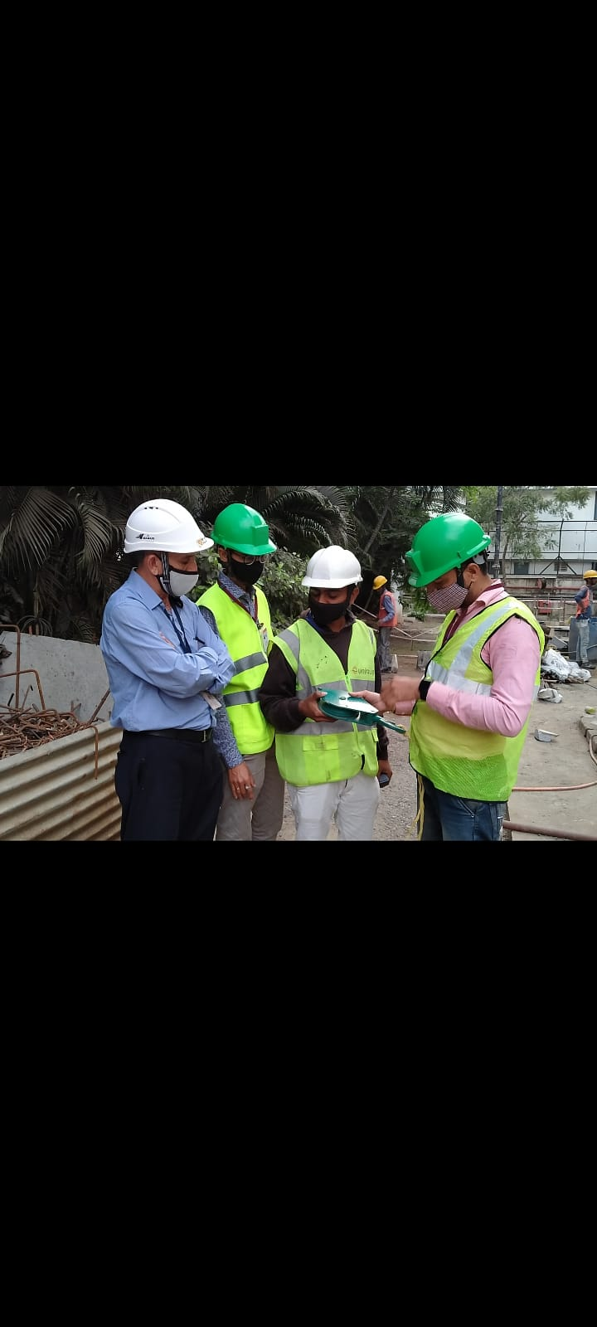
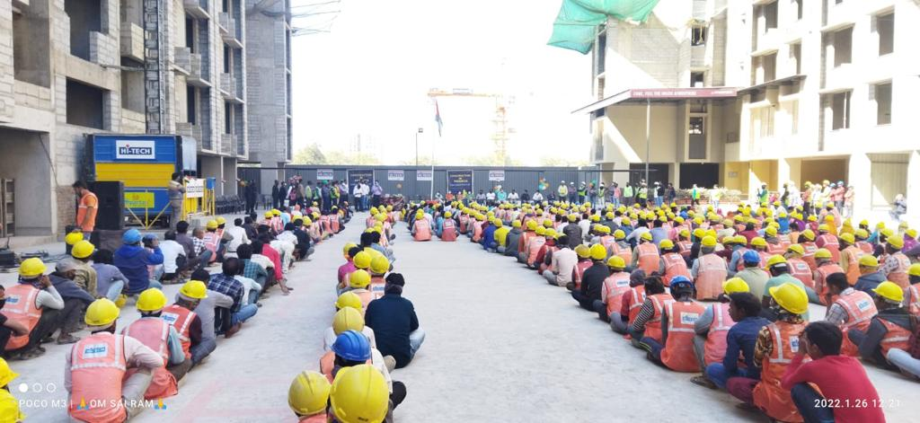
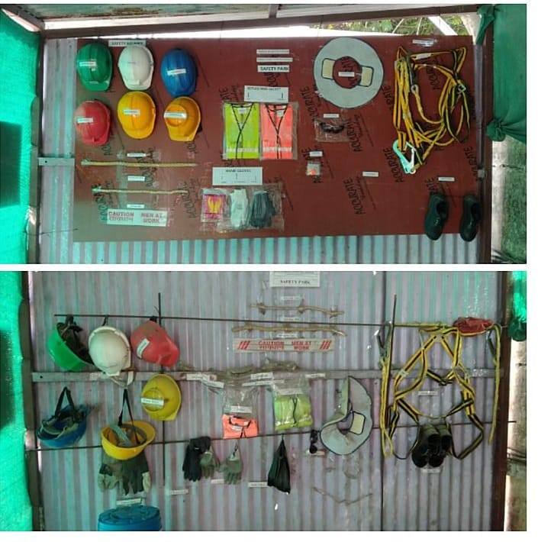
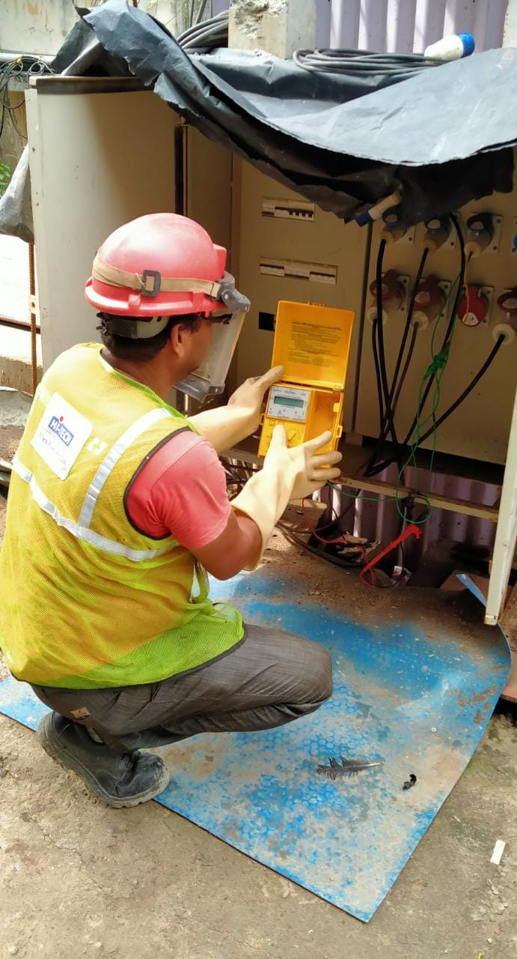
PHOTOS OF GOOD PRACTICES
MONTH- JAN 2022
26th jan celebration Site:- Sun atmosphere
Rope pulley inspection by client Site:- Torrent varaccha
Elcb/rccb testing Site:- Torrent varaccha
Safety park installation Site:- Torrent varaccha
PROJECT REVIEW MEETING – SAFETY REVIEW

Slide 3
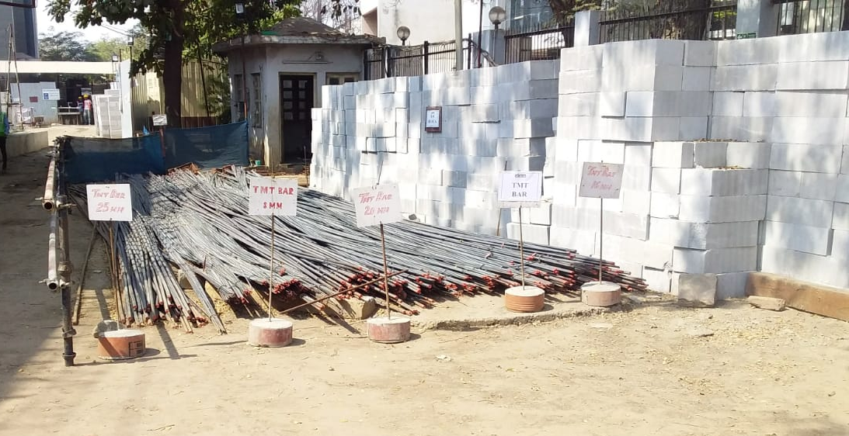
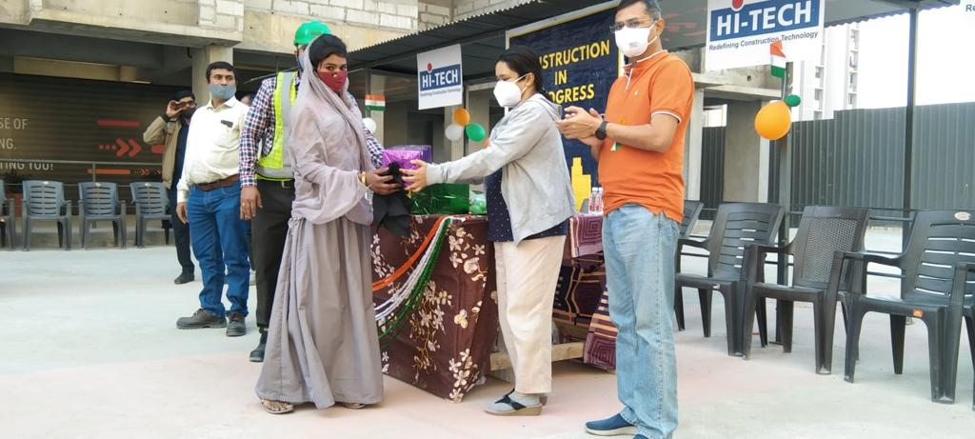
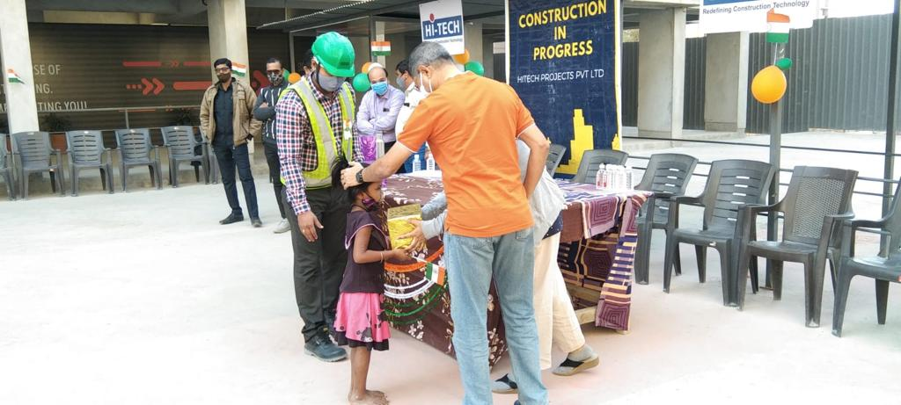
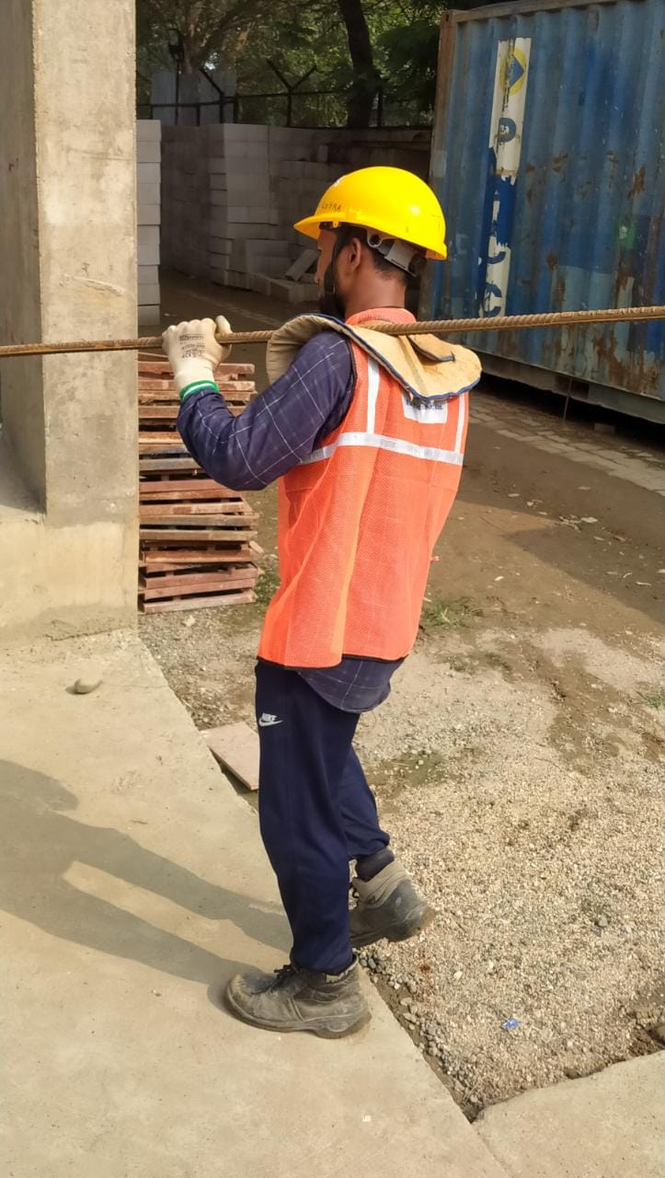
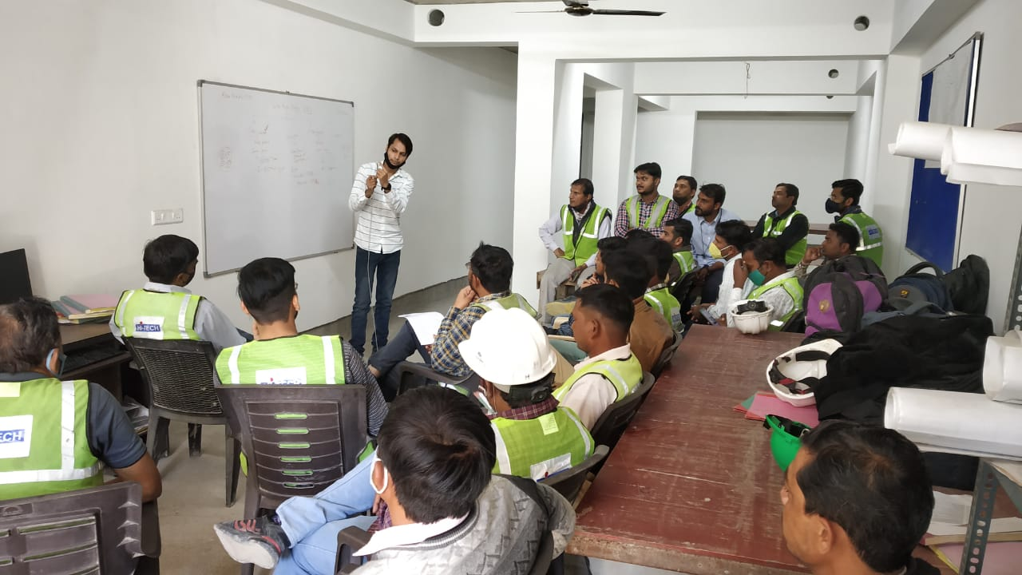
PHOTOS OF GOOD PRACTICES
MONTH- JAN 2022
Motivational /awareness program Site:- sun atmosphere
Dia wise placing of steel bars Site:- Torrent katargam
Job specific training Site:- sun atmosphere
Proper ppe’s for material shifting Site:- torrent varracha
PROJECT REVIEW MEETING – SAFETY REVIEW

